Slide 1


Logistic Regression
Logistic Regression
“An approach to make P(Y/X) computable”

Slide 2
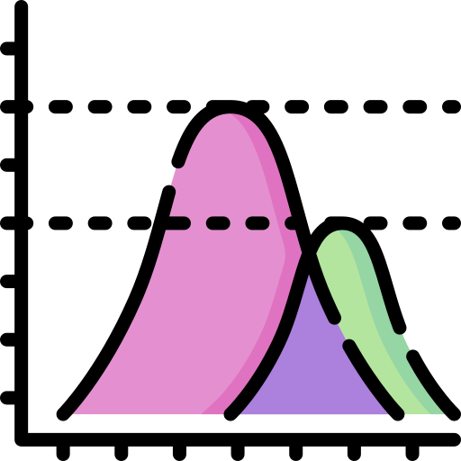

Probabilistic fundamentals
Logistic Regression
Principle of likelihood maximization
Estimation of the parameters

Slide 3
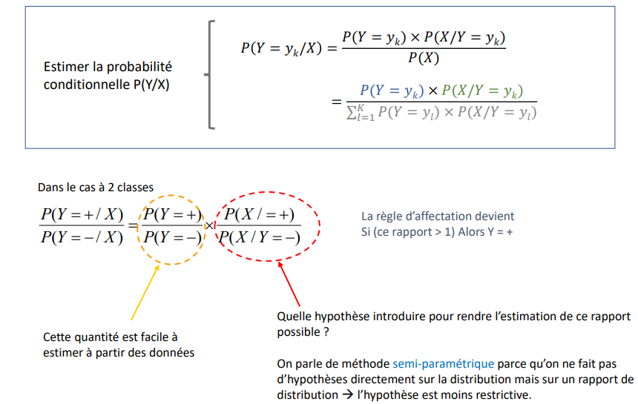
Bayes' theorem Conditional probabilities - We place ourselves in the binary frame Y € {+, -}
Logistic Regression
Estimate the conditional probability P(Y/X)
In the 2-class case
The assignment rule becomes
If (this ratio > 1) Then Y = +
What hypothesis should be introduced to make the estimation of this ratio possible?
The method is called semi-parametric because no assumptions are made directly on the distribution but on a distribution ratio → the assumption is less restrictive.
This quantity is easy to
estimate from the data

Slide 4
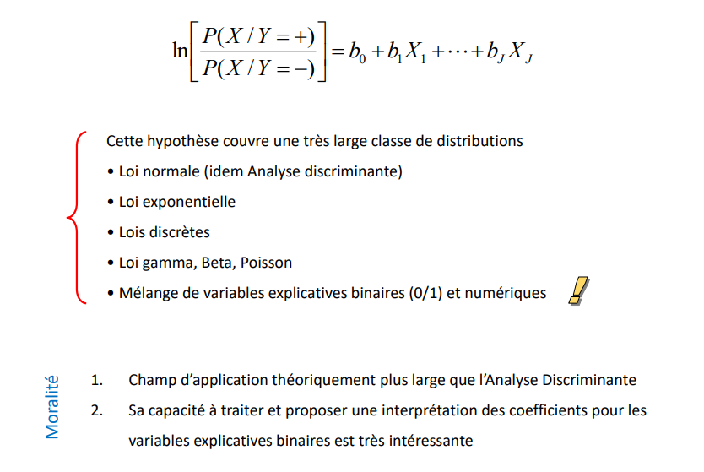
Basic assumption of logistic regression
Logistic Regression
This hypothesis covers a very large class of distributions
Normal law (idem Discriminant analysis)
Exponential law
Discrete laws
Gamma, Beta, Poisson law
Mixture of binary (0/1) and numerical explanatory variables
Morality
1. Theoretically broader scope than Discriminant Analysis
2. Its capacity to process and propose an interpretation of the coefficients for binary explanatory variables is very interesting

Slide 5
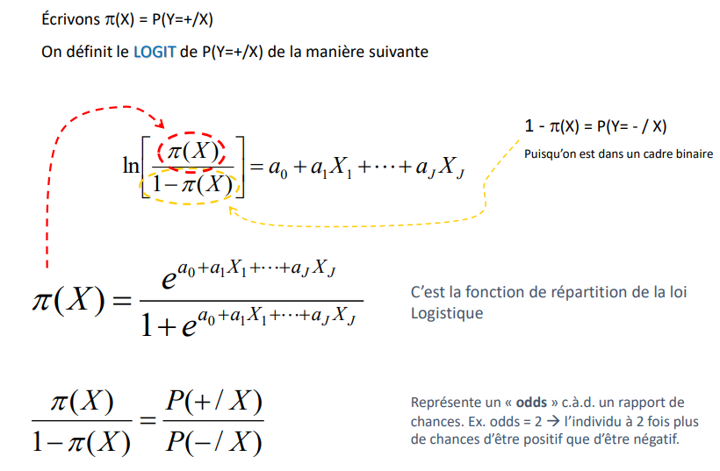
The LOGIT model Another writing of the probability ratio
Logistic Regression
Let us write π(X) = P(Y=+/X)
We define the LOGIT of P(Y=+/X) as follows
1 - π(X) = P(Y= - / X)
Since we are in a binary framework
It is the distribution function of the law
Logistics
Represents an "odds" i.e., a ratio of chances. Ex. odds = 2 → the individual has 2 times more chances of being positive than of being negative.

Slide 6
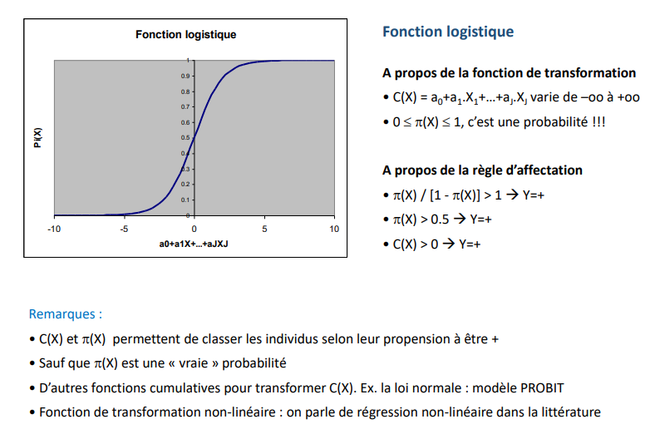
The logistics function Some elements of reading
Logistic Regression
Logistics function
About the transformation function
C(X) = a0+a1.X1+...+aJ.XJ varies from -oo to +oo
0 <= π(X) <= 1, that's a probability!!!
About the assignment rule
Remarks:
C(X) and π(X) allow us to classify individuals according to their propensity to be +
Except that π(X) is a "true" probability
Other cumulative functions to transform C(X). Ex. normal law: PROBIT model
Non-linear transformation function: we speak of non-linear regression in the literature

Slide 7
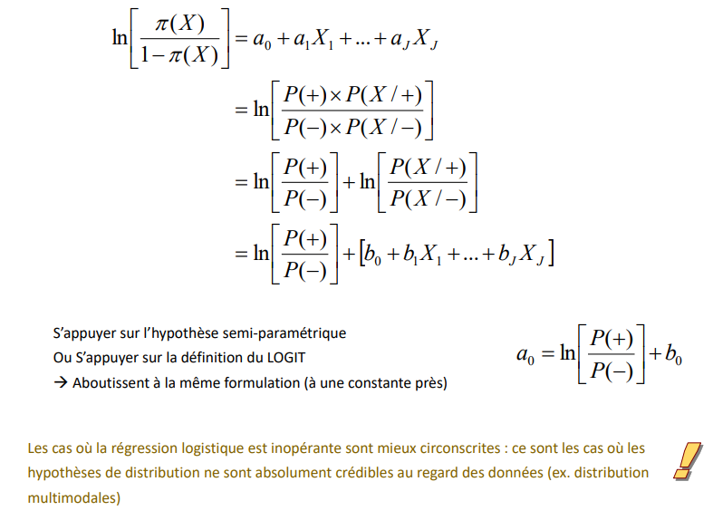
Equivalence between approaches
Logistic Regression
Rely on the semi-parametric hypothesis
Or Rely on the LOGIT definition
→ Result in the same formulation (except for one constant)
The cases where the logistic regression is inoperative are better circumscribed: these are the cases where the distribution hypotheses are not at all credible with respect to the data (e.g., multimodal distribution)

Slide 8
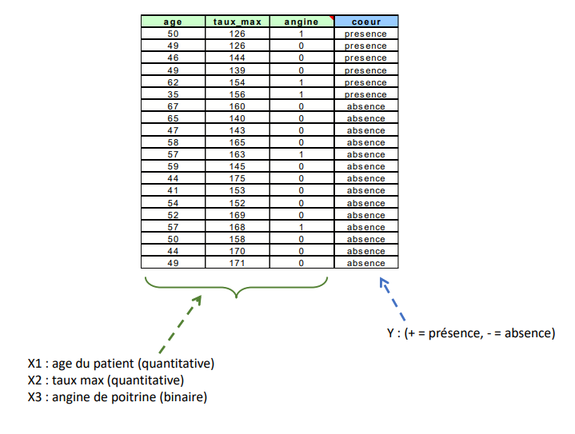
Example data for this medium Detection of heart disease
Logistic Regression
Y : (+ = presence, - = absence)
X1 : patient's age (quantitative)
X2 : max rate (quantitative)
X3 : angina (binary)

Slide 9
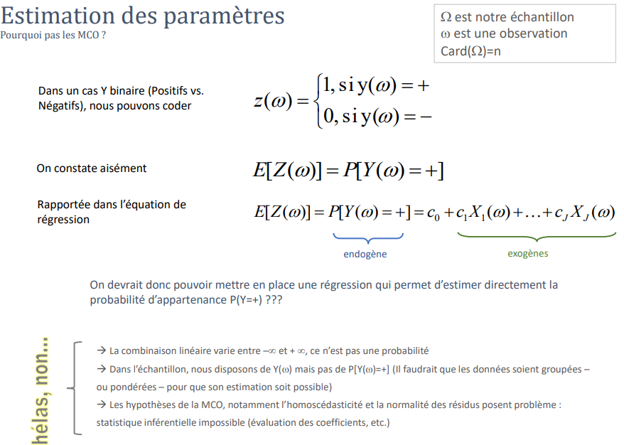
Parameter Estimation Why not OLS?
Logistic Regression
Ω is our sample
ω is an observation
Card(Ω) = n
In a binary Y case (Positives vs.
Negatives), we can code
It is easy to see
Reported in the
regression equation
endogenous
exogenous
We should therefore be able to set up a regression that allows us to directly estimate the probability of membership P(Y=+) ???
→ The linear combination varies between -inf and +inf, it is not a probability
→ In the sample, we have Y(ω) but not P[Y(ω)=+] (the data would have to be pooled - or weighted - for its estimation to be possible)
→ The assumptions of OLS, notably the homoscedasticity and normality of the residuals, are problematic: inferential statistics impossible (evaluation of coefficients, etc.)
Alas no

Slide 10
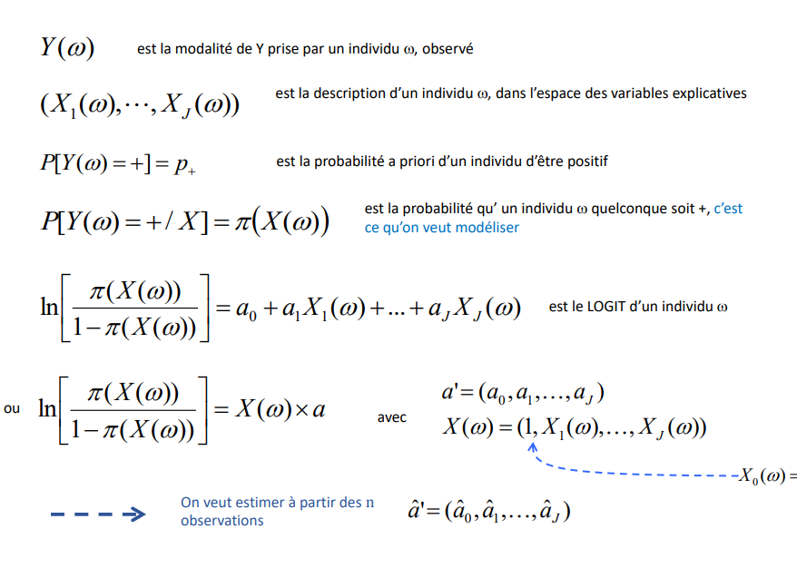
Notes on notation Some precisions on notations and expressions
Logistic Regression
is the modality of Y taken by an individual ω, observed
is the description of an individual ω, in the space of explanatory variables
is the a priori probability of an individual to be positive
is the probability that any individual is +, that is what we want to model
is the LOGIT of an individual ω
Where
With
We want to estimate from the n observations

Slide 11
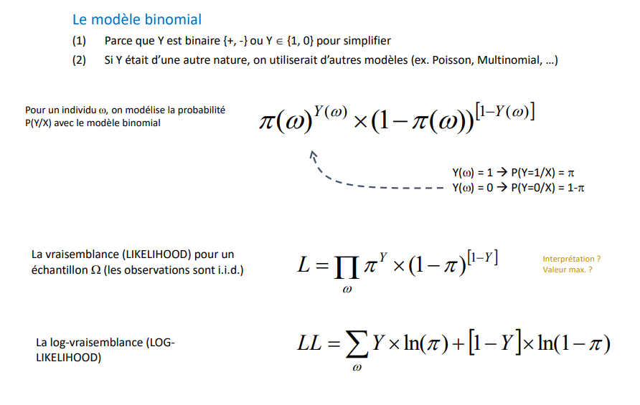
Estimation of parameters Define the likelihood
Logistic Regression
The binomial model
‎‎‎‎‎‎‎‎ㅤ
(1) Because Y is binary {+, -} or Y {1, 0} to simplify
(2) If Y was of another nature, we would use other models (e.g., Poisson, Multinomial, ...)
For an individual ω, we model the probability P(Y/X) with the binomial model
The likelihood (LIKELIHOOD) for a
sample Ω (the observations are i.i.d.)
Interpretation ?
Maximum value ?
The log-likelihood (LOGLIKELIHOOD)

Slide 12
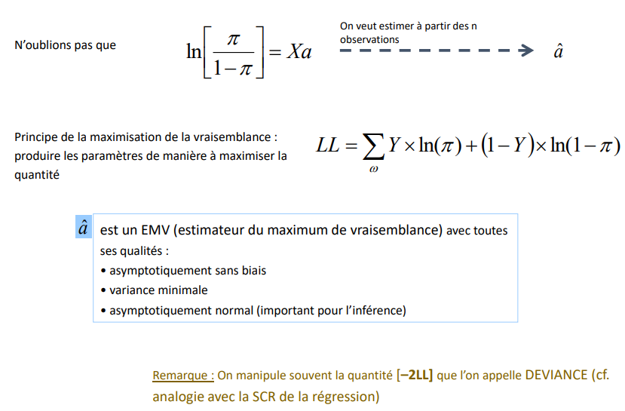
Estimation of parameters Maximum likelihood method
Logistic Regression
We want to estimate from the n observations
Let's not forget that
Principle of likelihood maximization: produce the parameters in a way that maximizes the quantity
is a MLE (maximum likelihood estimator) with all its qualities its qualities:
asymptotically unbiased
minimal variance
asymptotically normal (important for inference)
Note: We often manipulate the quantity [-2LL] which we call DEVIANCE (cf. analogy with the SCR of the regression)

Slide 13
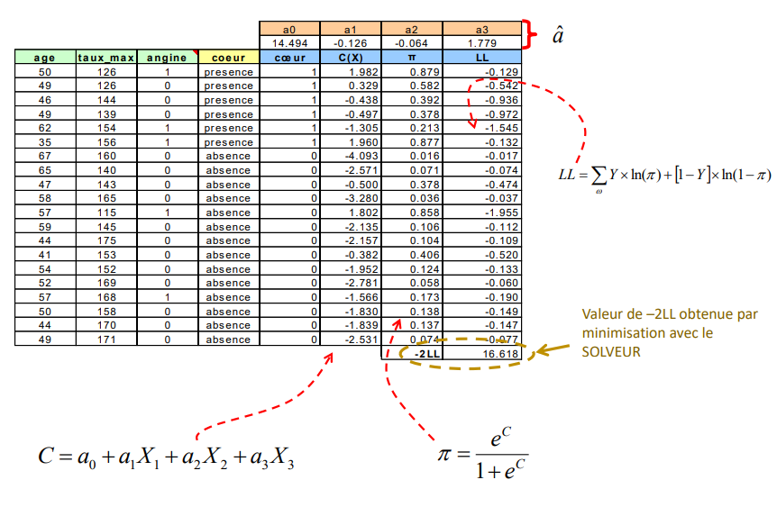
An example in EXCEL
Logistic Regression
Value of -2LL obtained by minimization with the SOLVER

Slide 14
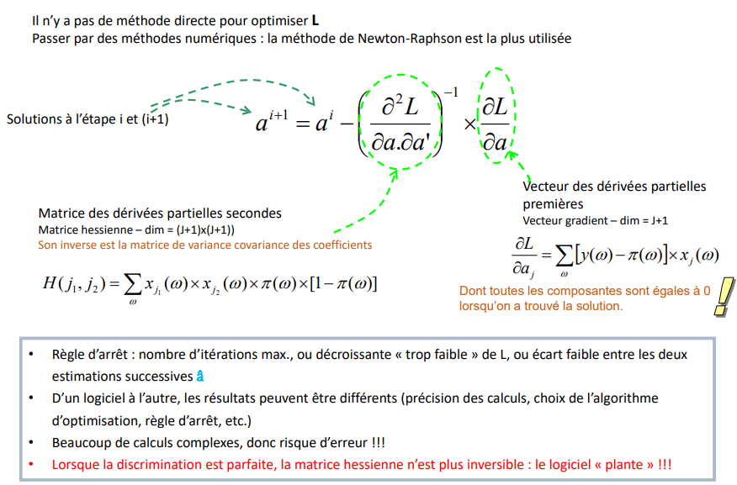
Estimation in practice - Newton Raphson method
Logistic Regression
There is no direct method to optimize L Use numerical methods: the Newton-Raphson method is the most used
Solutions at step i and (i+1)
Vector of partial derivatives
first Gradient vector - dim = J+1
Matrix of second partial derivatives
Hessian matrix - dim = (J+1)x(J+1)) Its inverse is the variance covariance matrix of the coefficients
All components of which are equal to 0
when the solution is found.
Stopping rule: maximum number of iterations, or "too low" decrease of L, or small difference between the two successive estimates â
From one software to another, the results can be different (precision of the calculations, choice of the optimization algorithm, stopping rule, etc.)
A lot of complex calculations, therefore risk of error!!!
When the discrimination is perfect, the Hessian matrix is no longer invertible: the software "crashes"!

Slide 15
Empirical" evaluation of the regression
Logistic Regression
Overall balance of the regression based on prediction and deviance

Slide 16
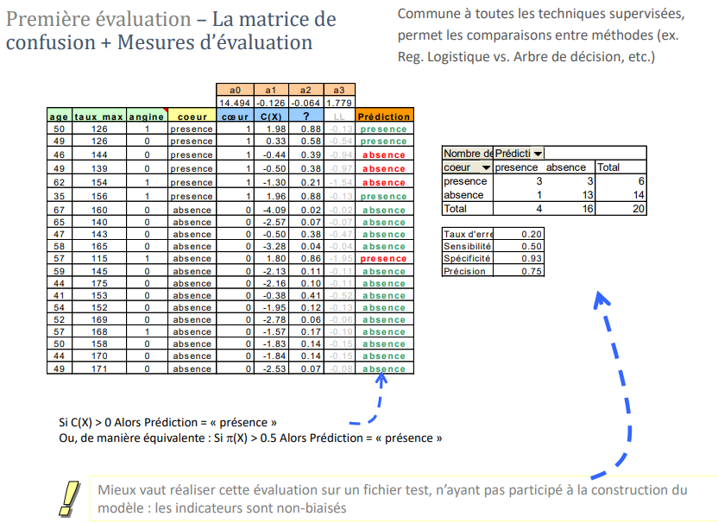
First evaluation - The confusion matrix Confusion Matrix + Evaluation Measures
Logistic Regression
Common to all supervised techniques, allows comparisons between methods (ex. Reg. Logistic vs. Decision Tree, etc.)
If C(X) > 0 then Prediction = "presence" Or, equivalently: If π(X) > 0.5 Then Prediction = "presence"
It is better to carry out this evaluation on a test file that has not been involved in the construction of the model : the indicators are unbiased

Slide 17
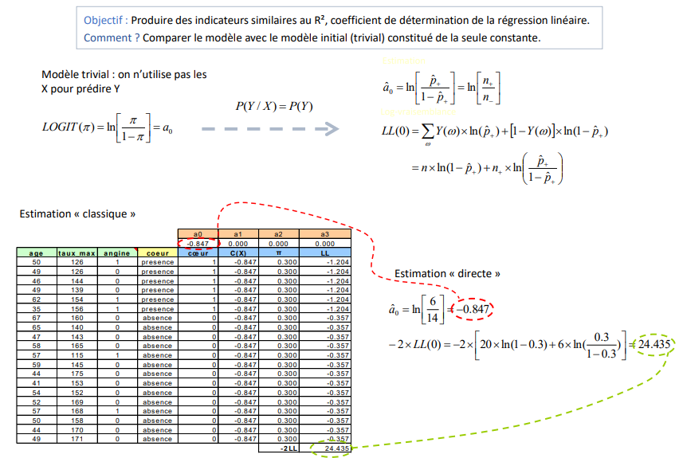
Second evaluation - The pseudo-R² Reference model: the initial model
Logistic Regression
Objective: To produce indicators similar to the R², coefficient of determination of the linear regression.
How? Compare the model with the initial (trivial) model consisting of the only constant.
Trivial model: we do not use the X to predict Y
“Classic" estimation
"Direct" estimation

Slide 18
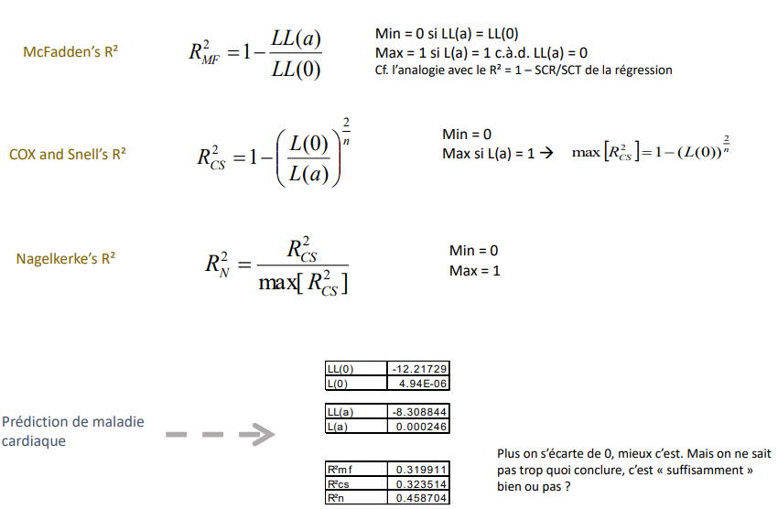
Second evaluation - Pseudo-R²'s Some indicators
Logistic Regression
Min = 0 if LL(a) = LL(0)
Max = 1 if L(a) = 1 i.e., LL(a) = 0
See the analogy with the R² = 1 - SCR/SCT of the regression
McFadden's R²
Min = 0
Max if L(a) = 1 →
COX et R² de Snell
Le R² de Nagelkerke
Min = 0
Max = 1
Prediction of heart disease
The further away from 0, the better. But we don't really know what to conclude, is it "good enough" or good or not ?

Slide 19
Empirical" evaluation of the regression
Logistic Regression
Assessment based on the quality of the scores provided by the regression

Slide 20
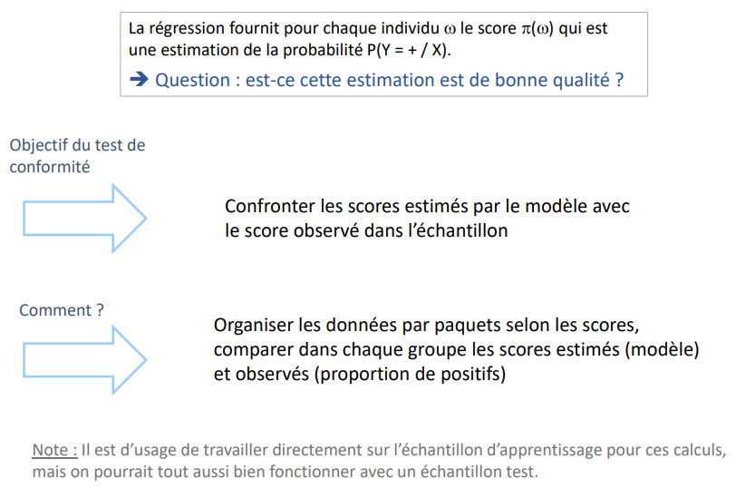
Evaluation of scores Adequacy between "scores" provided by the model and "scores" observed in the sample
Logistic Regression
The regression provides for each individual ω the score π(ω) which is an estimate of the probability P(Y = + / X).
→ Question: is this estimate of good quality?
Objective of the test compliance
Confront the scores estimated by the model with the score observed in the sample
How do we do it?
Organize the data by packets according to the scores, compare in each group the estimated (model) and observed (proportion of positives) scores and observed scores (proportion of positives)
Note: It is usual to work directly on the training sample for these calculations, but we could just as well work with a test sample.

Slide 21
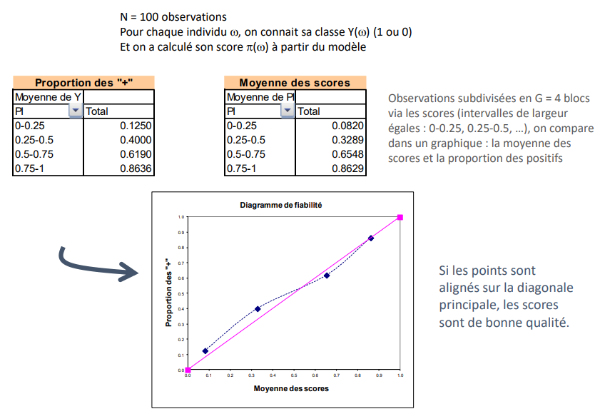
Reliability diagram Excerpt from the book " Pratique de la régression logistique " (in French)
Logistic Regression
N = 100 observations
For each individual ω, we know its class Y(ω) (1 or 0)
And we computed its score π(ω) from the model
Observations subdivided into G = 4 blocks via the scores (intervals of equal width 0-0.25, 0.25-0.5, ...), we compare in a graph: the average of the scores and the proportion of positives
If the points are aligned on the main diagonal main diagonal, the scores are of good quality

Slide 22
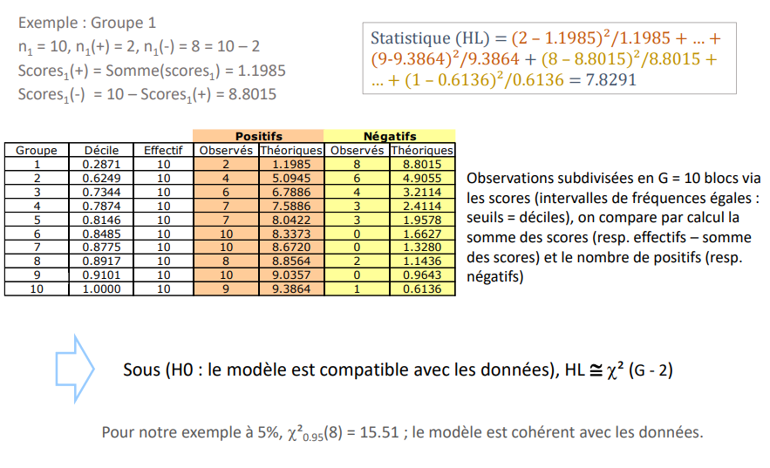
Hosmer & Lemeshow test Excerpt from the book " Pratique de la régression logistique " (in French)
Logistic Regression
Example : Group 1
n1 = 10, n1 (+) = 2, n1 (-) = 8 = 10 - 2
Scores1 (+) = Sum(scores1 ) = 1.1985
Scores1 (-) = 10 - Scores1 (+) = 8.8015
Observations subdivided into G = 10 blocks via the scores (intervals of equal frequencies : thresholds = deciles), we compare by calculation the sum of the scores (resp. numbers - sum of the of scores) and the number of positive (resp. negative)
Under (H0: the model is compatible with the data), HL ~ X² (G - 2)
For our example at 5%, X² 0.95(8) = 15.51; the model is consistent with the data.

Slide 23
Statistical evaluation of the Regression
Logistic Regression
Is the model statistically significant?
Are any of the variables relevant?

Slide 24
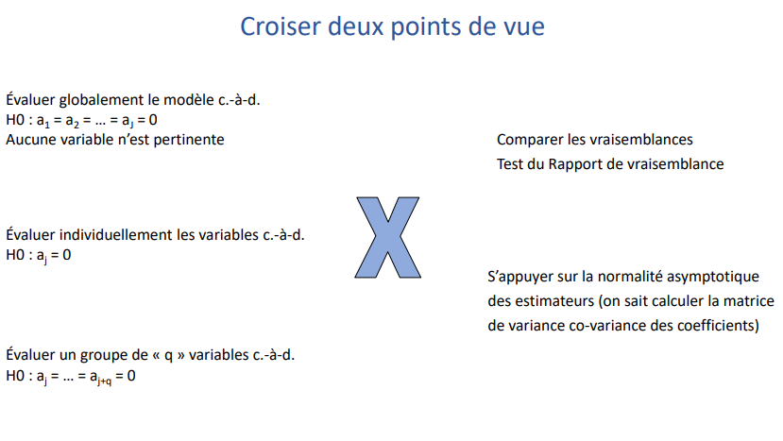
Statistical "evaluation" Rely on the probabilistic model derived from likelihood maximization
Logistic Regression
Crossing two points of view
Evaluate the model globally, i.e.
H0 : a1 = a2 = ... = aJ = 0
No variable is relevant
Comparing Likelihoods Likelihood Ratio Test
Evaluate the variables individually i.e.
H0: aj = 0
Rely on the asymptotic normality of the estimators (we know how to calculate the of variance co-variance of the coefficients)
Evaluate a group of "q" variables i.e.
H0 : aj = ... = aj+q = 0

Slide 25
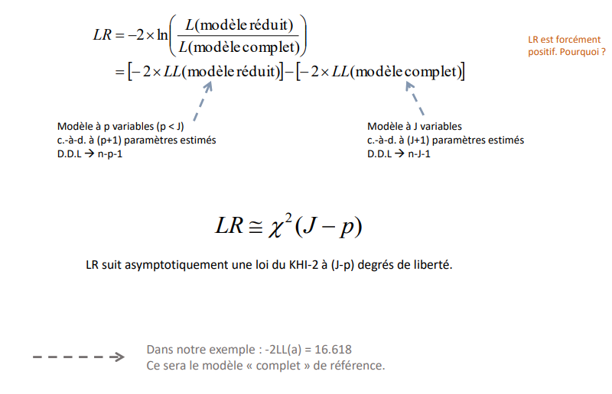
Likelihood ratio principle Compare the likelihood of nested models
Logistic Regression
Scaled model
Complete model
LR is necessarily positive. Why is that?
Scaled model
Complete model
Model with p variables (p < J)
i.e., with (p+1) estimated parameters
D.D.L → n-p-1
Model with J variables
i.e., with (J+1) estimated parameters
D.D.L → n-J-1
LR asymptotically follows a KHI-2 distribution with (J-p) degrees of freedom
In our example: -2LL(a) = 16.618 This will be the "complete" reference model.

Slide 26
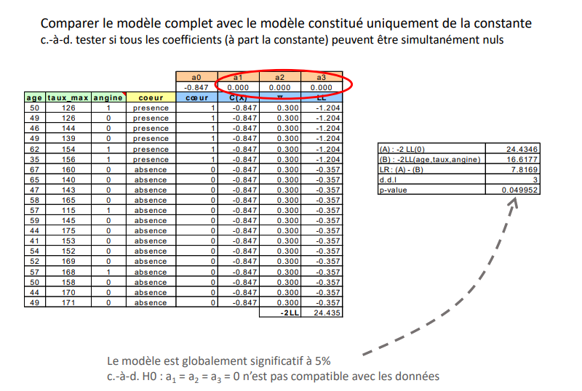
Likelihood ratio principle Overall evaluation of the model
Logistic Regression
Compare the complete model with the model consisting only of the constant i.e., test if all coefficients (except the constant) can be simultaneously zero
The model is globally significant at 5%. i.e., H0 : a1 = a2 = a3 = 0 is not compatible with the data

Slide 27
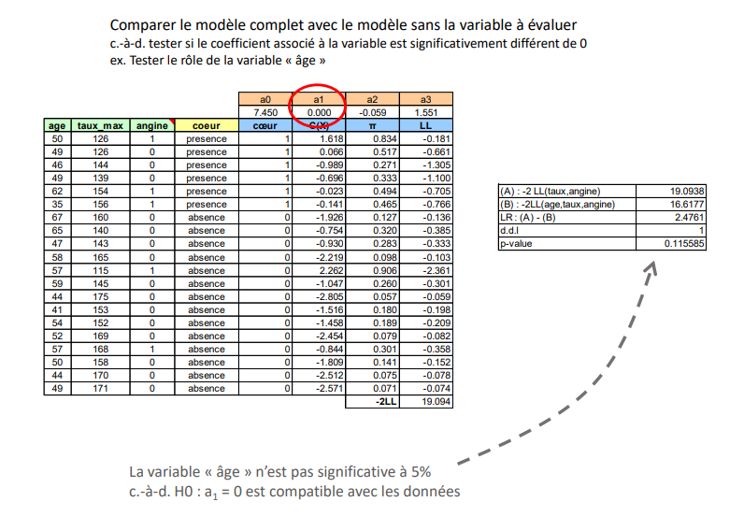
Likelihood ratio principle Evaluate individual variables
Logistic Regression
Compare the complete model with the model without the variable to be evaluated i.e., test if the coefficient associated with the variable is significantly different from 0 e.g., Test the role of the variable "age"
The "age" variable is not significant at the 5% level, i.e., H0: a1 = 0 is compatible with the data

Slide 28
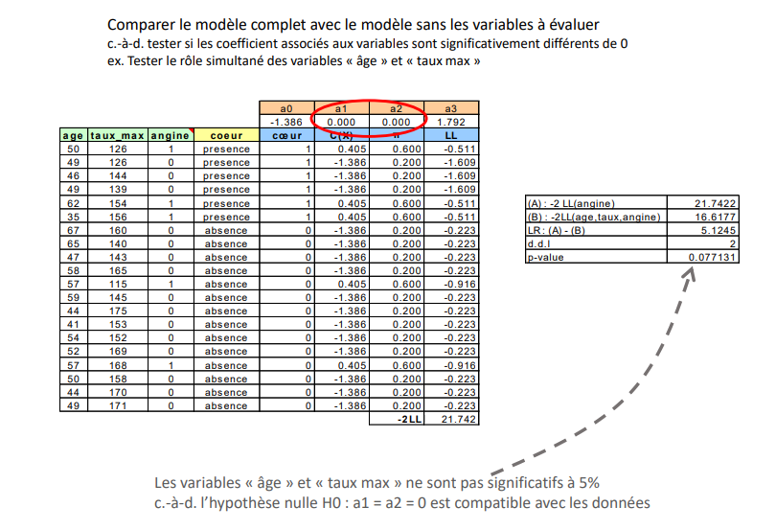
Likelihood ratio principle Evaluating a group of variables
Logistic Regression
Compare the complete model with the model without the variables to be evaluated i.e., test if the coefficients associated with the variables are significantly different from 0 e.g., Test the simultaneous role of the "age" and "max rate" variables
The variables "age" and "max rate" are not significant at the 5% level i.e., the null hypothesis H0: a1 = a2 = 0 is compatible with the data

Slide 29
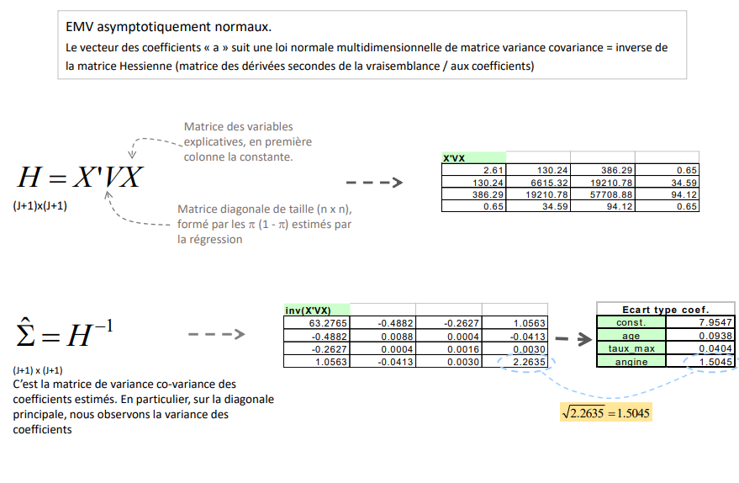
Tests based on the asymptotic normality of the coefficients Principle - Wald test
Logistic Regression
Asymptotically normal MLE.
The vector of coefficients "a" follows a multidimensional normal distribution of matrix variance covariance = inverse of the Hessian matrix (matrix of the second derivatives of the likelihood / the coefficients)
Matrix of explanatory variables explanatory variables, in the first column the constant
Diagonal matrix of size (n x n), formed by the π (1 - π) estimated by the regression
standard deviation
It is the co-variance matrix of the estimated coefficients. In particular, on the main diagonal we observe the variance of the coefficients

Slide 30
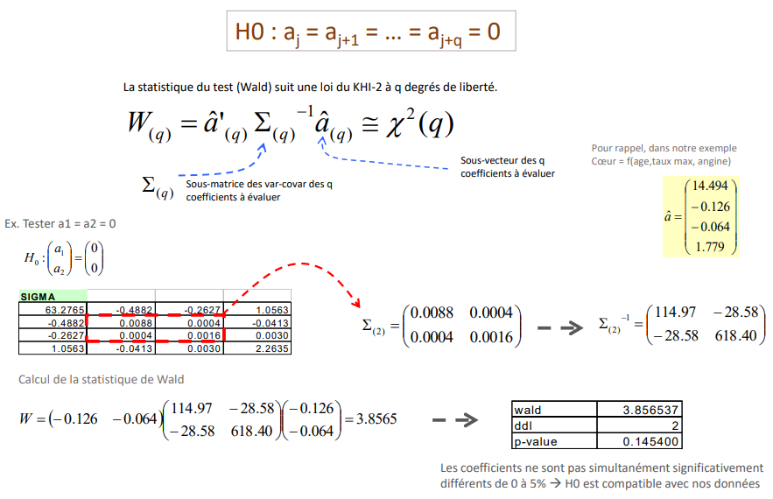
Wald test Assessing the significance of a group of "q" variables
Logistic Regression
The test statistic (Wald) follows a KHI-2 distribution with q degrees of freedom.
As a reminder, in our example Heart = f(age, max rate, angina)
Sub-vector of q coefficients to be evaluated
Sub-matrix of the var-covar of the q coefficients to be evaluated
Ex. test a1 = a2 = 0
Calculation of the Wald statistic
The coefficients are not simultaneously significantly different from 0 to 5% → H0 is compatible with our data

Slide 31
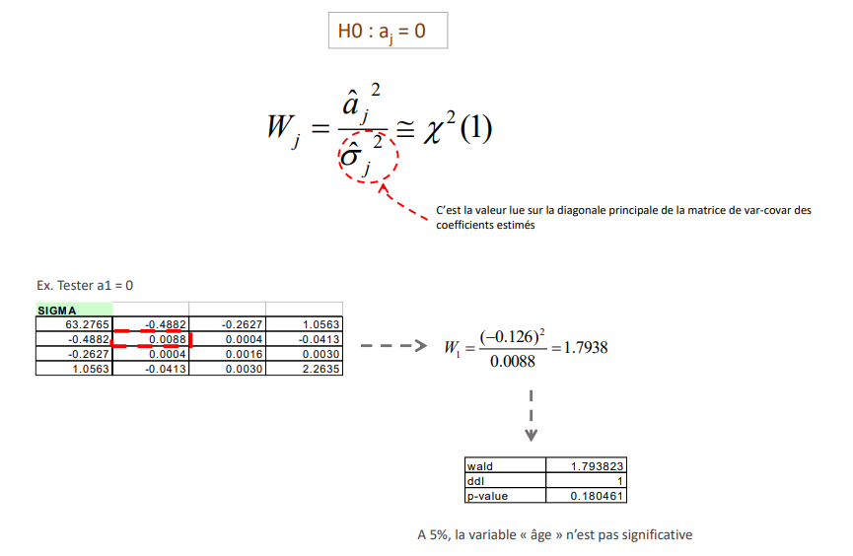
Wald test Significance of a variable
Logistic Regression
It is the value read on the main diagonal of the var-covar matrix of the estimated coefficients
Ex. test a1 = 0
At 5%, the "age" variable is not significant

Slide 32
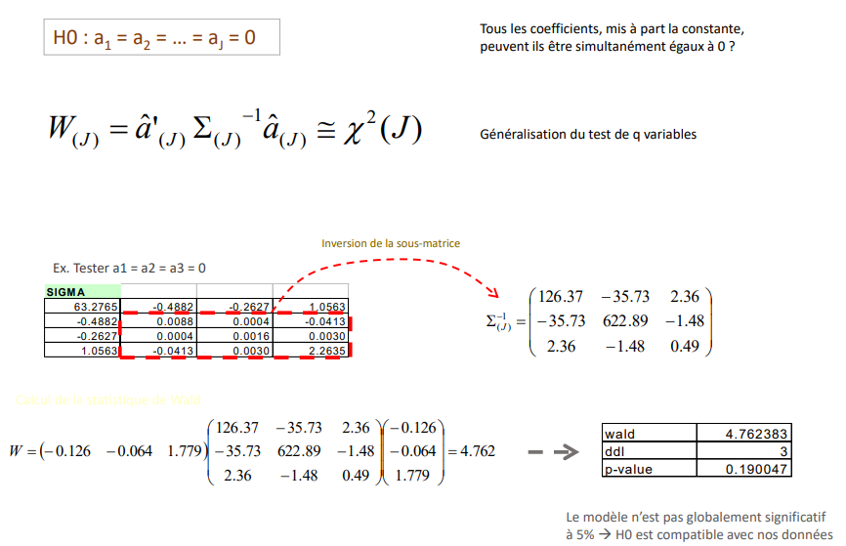
Wald test Overall significance of the model
Logistic Regression
Can all the coefficients, except the constant, can they be simultaneously equal to 0 ?
Generalization of the q-variable test
Inversion of the submatrix
E.g., Test a1 = a2 = a3 = 0
Calculation of the Wald statistic
The model is not globally significant at 5% → H0 is compatible with our data

Slide 33
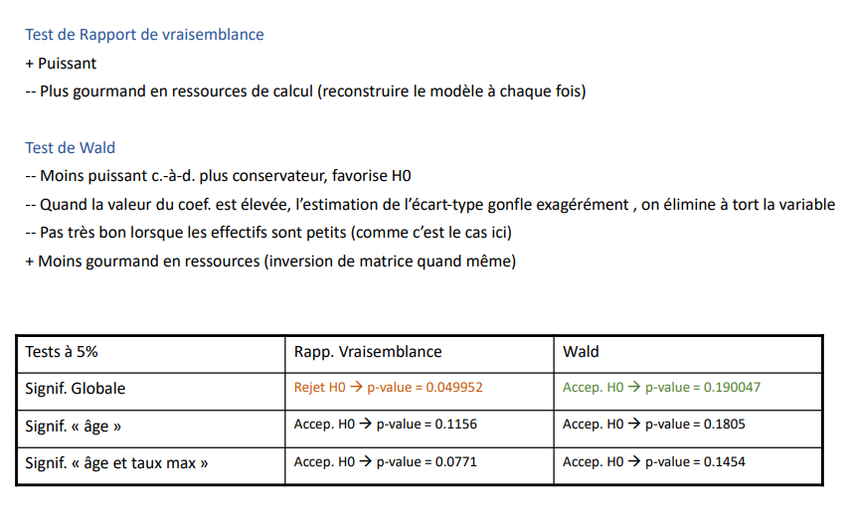
Wald test Overall significance of the model
Logistic Regression
Likelihood Ratio Test
+ More powerful
-- More computationally intensive (rebuild the model each time)
Wald test
-- Less powerful, i.e., more conservative, favours H0
-- When the value of the coef. is high, the estimate of the standard deviation is exaggerated, the variable is wrongly eliminated
-- Not very good when the numbers are small (as is the case here)
+ Less resource intensive (matrix inversion anyway)
Tests at 5% | Rapp. Likelihood | Wlad
Global Signif. | Rejection H0 p-value = 0.049952 | Accept. H0 p-value = 0.190047
Significance "Age" | Accept. H0 p-value = 0.1156 | Accept. H0 p-value = 0.1805
Significance of "age and max rate" | Accept. H0 p-value = 0.0771 | Accept. H0 p-value = 0.1454

Slide 34
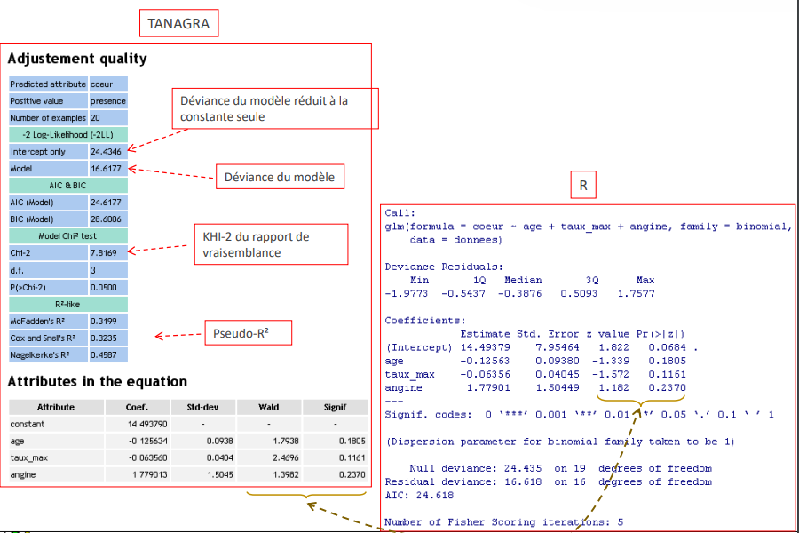
Reading software results - Tanagra and R
Logistic Regression
Deviance of the model reduced to the
constant alone
Deviance of the model
KHI-2 of the likelihood ratio
Pseudo-R²

Slide 35
reading and interpretation of coefficients
Logistic Regression
What makes logistic regression successful

Slide 36
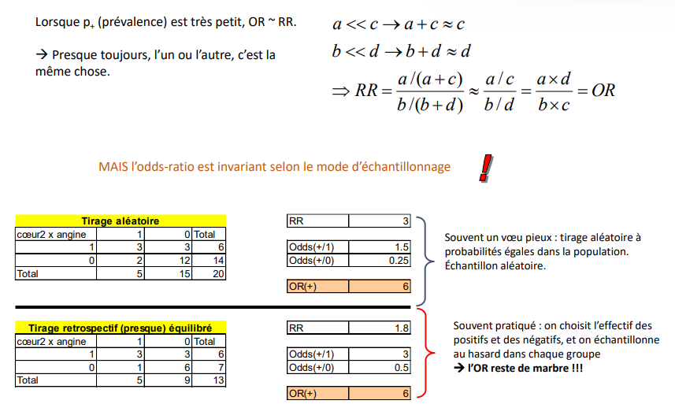
Relative risk, Odds, Odds-Ratio Why choose the Odds-Ratio?
Logistic Regression
When p+ (prevalence) is very small, OR ~ RR.
→ Almost always, one or the other is the same thing.
BUT the odds ratio is invariant to the sampling mode
Random draw
Often a wishful thinking: random draw with equal probabilities in the population. Random sample.
Retrospective draw (almost) balanced
Often practiced: we choose the number of positives and negatives and negatives, and we sample randomly in each group randomly in each group
→ the RB remains unchanged

Slide 37
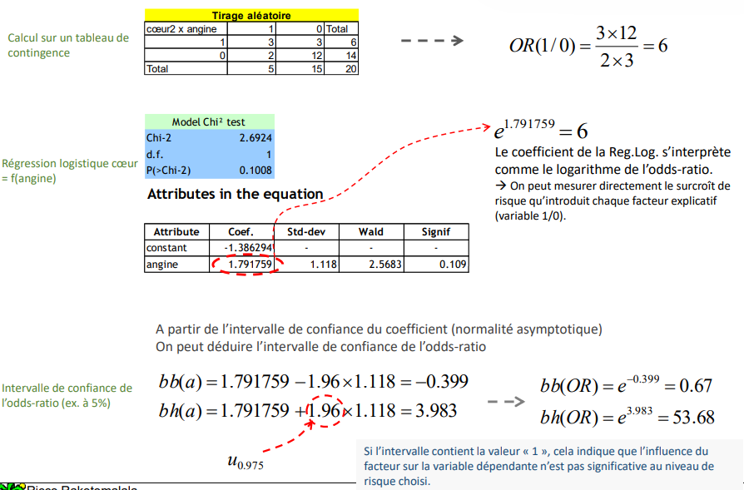
Odds-ratio What does this have to do with logistic regression?
Logistic Regression
Random draw
Calculation on a table of contingency table
Logistic regression heart = f(angina)
The coefficient of the Reg.Log. is interpreted as the logarithm of the odds ratio.
→ The incremental risk introduced by each explanatory factor can be measured directly (1/0 variable).
From the confidence interval of the coefficient (asymptotic normality) We can deduce the confidence interval of the odds ratio
Confidence interval of odds ratio (e.g., at 5%)
If the interval contains the value "1", this indicates that the influence of the factor on the factor on the dependent variable is not significant at the chosen risk level.

Slide 38
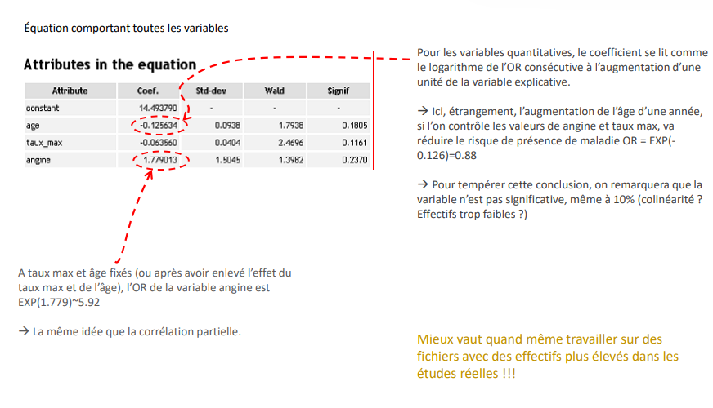
Odds-Ratio Partial OR and OR of continuous variables
Logistic Regression
Equation with all variables
For quantitative variables, the coefficient is read as the logarithm of the OR following the increase of one unit of the unit increase in the explanatory variable.
→ here, strangely, the increase in age by one year, if we control for angina and max rate, will reduce the risk of reduce the risk of the presence of disease OR = EXP(- 0.126)=0.88
→ To temper this conclusion, it should be noted that the variable is not variable is not significant, even at 10% (collinearity? Too small a number?)
With fixed max rate and age (or after removing the effect of max rate and age), the rate and age), the OR of the angina variable is EXP(1.779)~5.92
→ The same idea as the partial correlation.
It is still better to work on files with files with higher numbers in real studies! real studies!!!

Slide 39
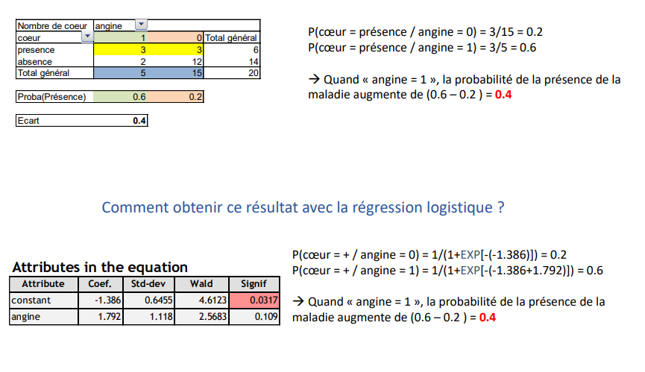
Odds-Ratio Going beyond Odds-Ratios - Reading in terms of probability differentials
Logistic Regression
P(heart = presence / angina = 0) = 3/15 = 0.2
P(heart = presence / angina = 1) = 3/5 = 0.6
→ When "angina = 1", the probability of the presence of the disease increases by (0.6 - 0.2 ) = 0.4
How to obtain this result with logistic regression?
P(heart = + / angina = 0) = 1/(1+EXP[-(-1.386)]) = 0.2
P(heart = + / angina = 1) = 1/(1+EXP[-(-1.386+1.792)]) = 0.6
→ When "angina = 1", the probability of the presence of the disease increases by (0.6 - 0.2 ) = 0.4

Slide 40
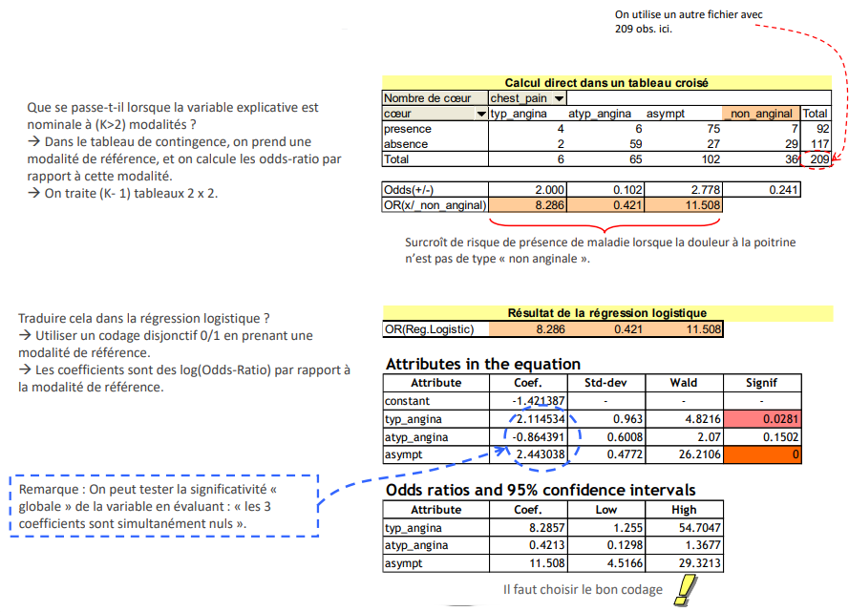
Treatment of categorical explanatory variables With more than 2 modalities
Logistic Regression
We use another file with 209 obs. here.
Direct calculation in a pivot table
What happens when the explanatory variable is nominal with (K>2) modalities?
→ In the contingency table, we take a reference modality, and we calculate the modality, and we calculate the odds-ratio with respect to this modality. with respect to this modality.
→ We treat (K- 1) 2 x 2 tables.
Increased risk of disease presence when chest pain is not "non-anginal is not of the "non-anginal" type.
Translate this into logistic regression?
→ Use a 0/1 disjunctive coding by taking a reference modality.
→ The coefficients are log(Odds-Ratio) with respect to the reference modality.
Result of the logistic regression
Note: We can test the "global" significance of the variable by evaluating of the variable by evaluating: "the 3 coefficients are simultaneously zero".
You must choose the right coding

Slide 41
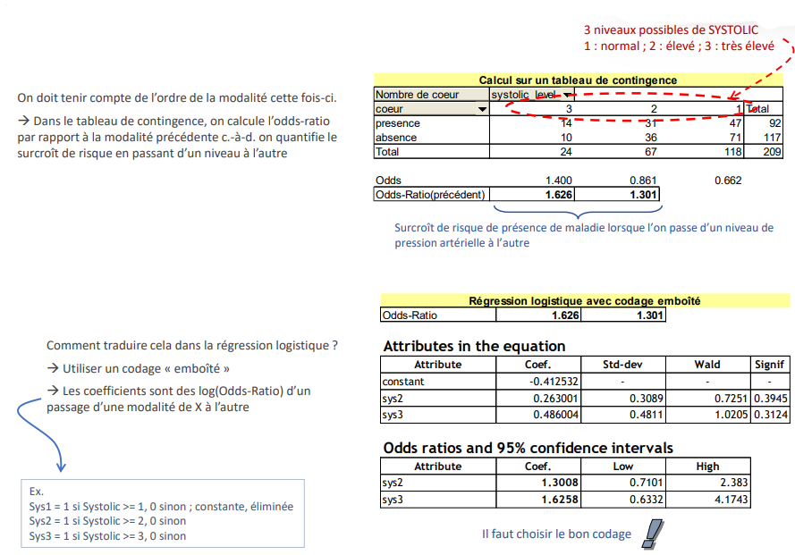
Treatment of ordinal explanatory variables An ordinal qualitative variable with K modalities
Logistic Regression
3 possible levels of SYSTOLIC
1: normal; 2: high; 3: very high
Calculation on a contingency table
The order of the modality must be taken into account this time.
→ In the contingency table, we calculate the odds ratio with respect to the previous modality, i.e., we quantify the of risk by going from one level to the other
Increased risk of disease when moving from one blood pressure level to another from one blood pressure level to another
Logistic regression with nested coding
How to translate this into logistic regression?
→ Use "nested" coding
→ The coefficients are log(Odds-Ratio) of a passage from one modality of X to the other
Ex.
Sys1 = 1 if Systolic >= 1, 0 otherwise ; constant, eliminated
Sys2 = 1 if Systolic >= 2, 0 otherwise
Sys3 = 1 if Systolic >= 3, 0 otherwise
You must choose the right coding

Slide 42
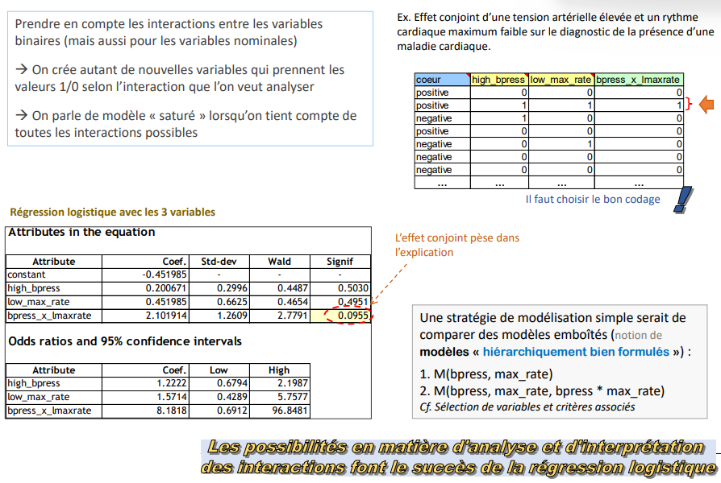
Taking interactions into account In LOGIT, the effects are initially additive, how to overcome it?
Logistic Regression
Take into account the interactions between binary variables (but also for binary variables (but also for nominal variables)
→ We create as many new variables that take the values 1/0 values according to the interaction we want to analyse
→ We speak of a "saturated" model when we take into account all all possible interactions are taken into account
Ex. Joint effect of high blood pressure and low maximum heart rate on the diagnosis of the presence of a cardiac disease. heart disease.
Logistic regression with the 3 variables
You must choose the right coding
The joint effect weighs in the explanation
A simple modelling strategy would be to compare nested models (notion of "well formulated" models) well formulated" models):
1. M(bpress, max_rate)
2. M(bpress, max_rate, bpress * max_rate)
See Selection of variables and associated criteria
the possibilities for analysing and interpreting interactions make logistic regression successful

Slide 43
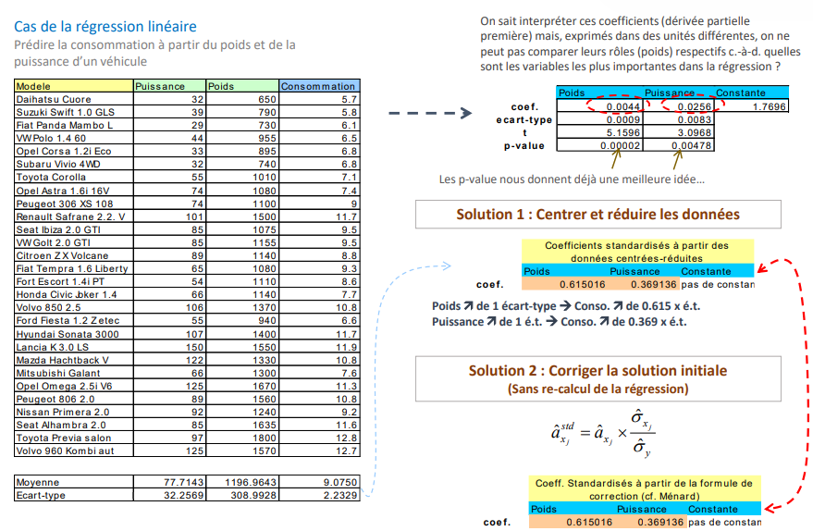
Compare the relative weight of variables Unstandardized coefficients vs. standardized coefficients
Logistic Regression
The case of linear regression
Predicting consumption from the weight and power of a vehicle
We know how to interpret these coefficients (partial derivative derivative) but, expressed in different units, we cannot compare their respective their respective roles (weights), i.e., which variables are more important in the are the most important variables in the regression?
The p-value already gives us a better idea...
Solution 1: Focus and reduce data
Standardized coefficients from centred-reduced data
Solution 2: Correct the initial solution
(Without recalculation of the regression)
Standardised coefficients from the correction form correction formula (cf. Ménard)

Slide 44
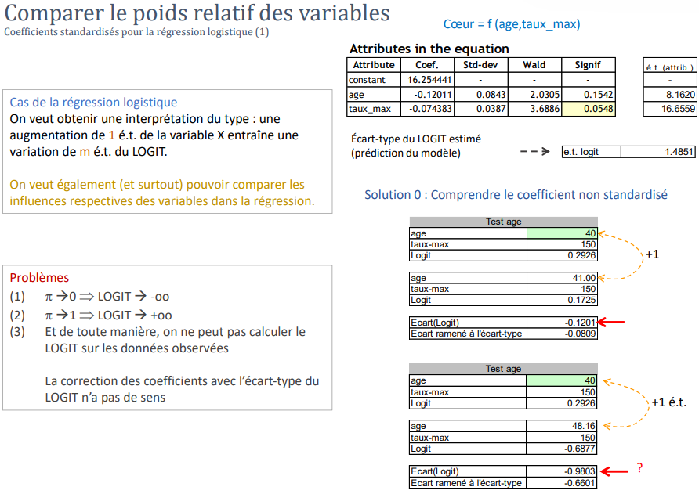
Comparing the relative weight of variables Standardized coefficients for logistic regression (1)
Logistic Regression
Heart = f (age,rate_max)
The case of logistic regression
We want to obtain an interpretation of the type: an increase of 1 SD in the variable X increase of 1 s.d. of the variable X leads to a variation of m variation of m SD of the LOGIT.
We also (and especially) want to be able to compare the respective influences of the respective influences of the variables in the regression
Standard deviation of estimated LOGIT (model prediction)
Solution 0: Understanding the non-standardized coefficient
Problems
(1) π → 0 ➔ LOGIT → -oo
(2) π → 1 ➔ LOGIT → +oo
(3) And anyway, we cannot compute the LOGIT on the observed data
The correction of the coefficients with the standard deviation of the LOGIT does not make sense

Slide 45
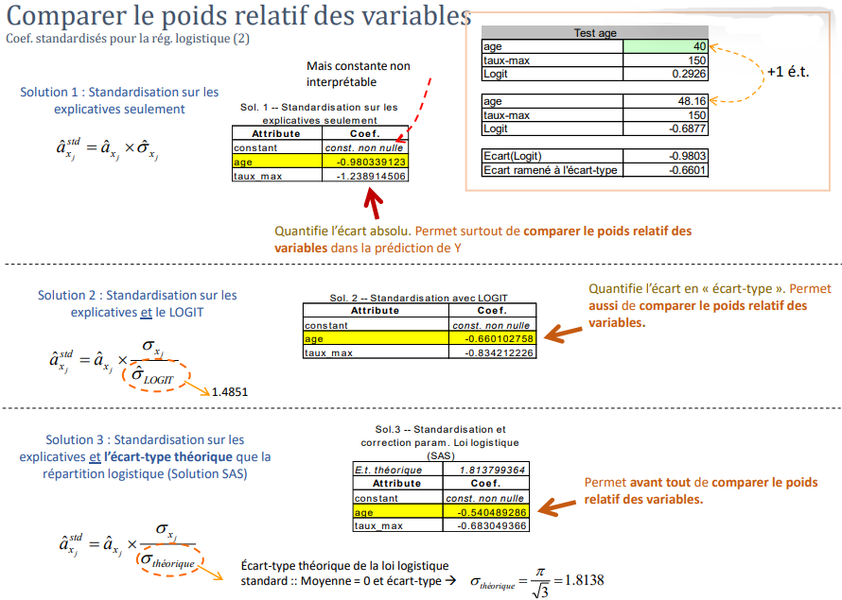
Comparing the relative weight of variables Standardized Coeff. for logistic reg. (2)
Logistic Regression
But uninterpretable constant
interpretable
Solution 1: Standardization on explanatory only
Sol. 1 -- Standardization on explanatory only
Quantifies the absolute difference. Allows to compare the relative weight of the variables in the variables in the prediction of Y
Solution 2: Standardization on and LOGIT
Standard deviation of estimated LOGIT (model prediction)
Quantifies the difference in "standard deviation". Allows also to compare the relative weight of the variables.
Solution 3: Standardization on the and the theoretical standard deviation that the logistic distribution (SAS solution)
Standard deviation of estimated LOGIT (model prediction)
Allows, above all, to compare the relative weight of the variables.
Theoretical standard deviation of the logistic law
standard :: Mean = 0 and standard deviation

Slide 46
variable selection
Logistic Regression
Choose the relevant variables for the regression

Slide 47
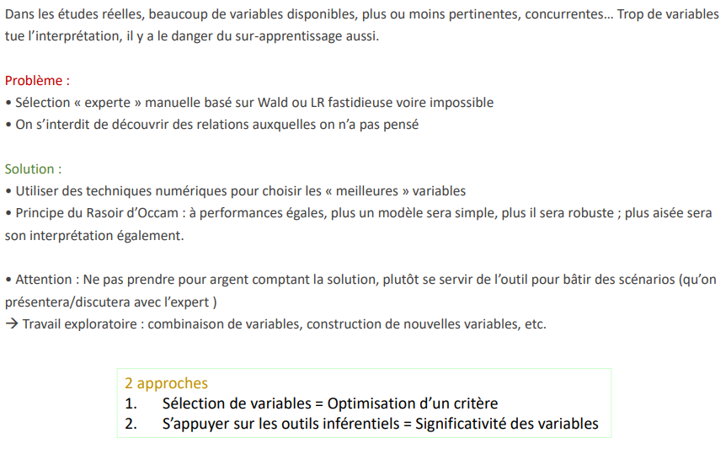
Selection of variables in practice Many candidates, few elected (desirable)
Logistic Regression
In real studies, many variables are available, more or less relevant, competing... Too many variables kills the interpretation, there is also the danger of over-learning.
Problem:
Manual "expert" selection based on Wald or LR tedious if not impossible
We forbid ourselves to discover relationships that we have not thought of
Solution:
Use numerical techniques to select the "best" variables Occam's Razor Principle: with equal performance, the simpler the model, the more robust it will be; the easier it will be easier it will be to interpret.
Caution: Do not take the solution at face value, rather use the tool to build scenarios (which will be presented/discussed with the (to be presented/discussed with the expert)
→ Exploratory work: combination of variables, construction of new variables, etc.
2 approaches
1. Variable selection = Optimization of a criterion
2. Rely on inferential tools = Significance of variables

Slide 48
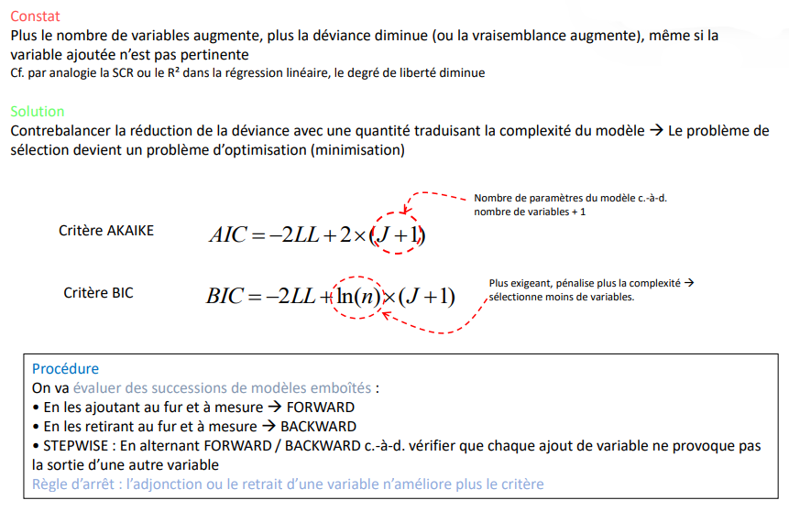
Selection by optimization AIC (Akaïke) and BIC (Schwartz) criteria
Logistic Regression
Observation
As the number of variables increases, the deviance decreases (or the likelihood increases), even if the added variable is not variable added is not relevant
Cf. by analogy the SCR or the R² in linear regression, the degree of freedom decreases
Solution
Counterbalance the deviance reduction with a quantity reflecting the complexity of the model → The selection problem becomes an optimization problem (minimization)
Number of model parameters i.e.
number of variables + 1
Criterion AKAIKE
BIC criterion
More demanding, penalizes more complexity →
selects fewer variables.
Procedure
We are going to evaluate successions of nested models:
By adding them as we go FORWARD
By removing them progressively BACKWARD
STEPWISE: By alternating FORWARD / BACKWARD i.e., check that each addition of a variable does not cause the output of another variable
Stop rule : adding or removing a variable does not improve the criterion anymore

Slide 49
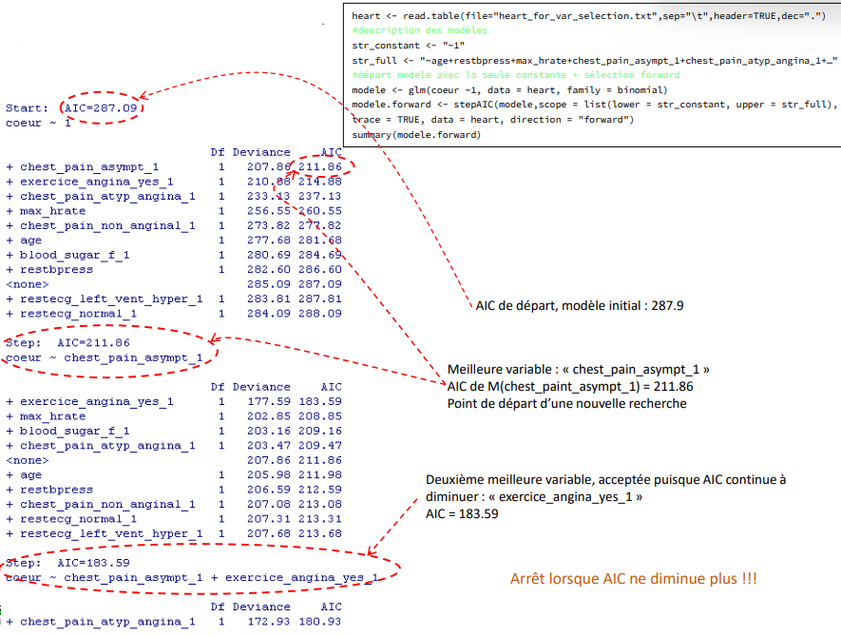
Selection by optimization FORWARD selection detail in R
Logistic Regression
Starting AIC, initial model: 287.9
Best variable: "chest_paint_asympt_1 AIC of M(chest_paint_asympt_1) = 211.86 Starting point for a new search
Second best variable, accepted since AIC continues to decrease: "exercise_angina_yes_1 AIC = 183.59
Stop when AIC no longer decreases!!!

Slide 50
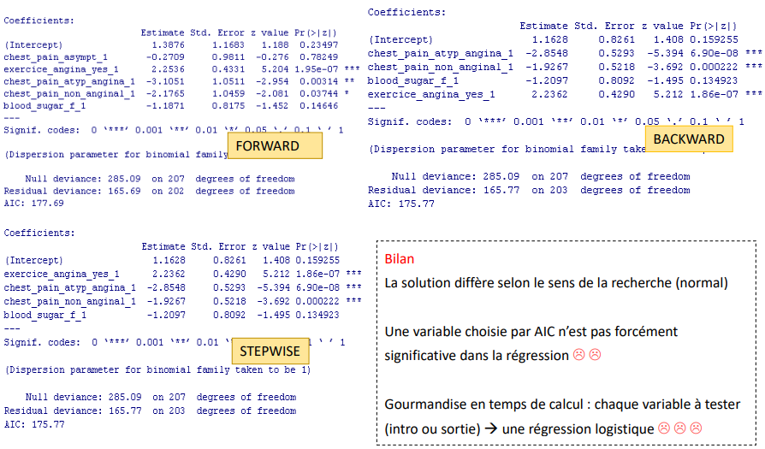
Selection by optimization Comparison of solutions: FORWARD, BACKWARD, BOTH (#STEPWISE)
Logistic Regression
Balance sheet
The solution differs according to the direction of the search (normal)
A variable chosen by AIC is not necessarily significant in the regression :( :(
Greed in computation time: each variable to be tested (intro or output) → a logistic regression :( :(

Slide 51
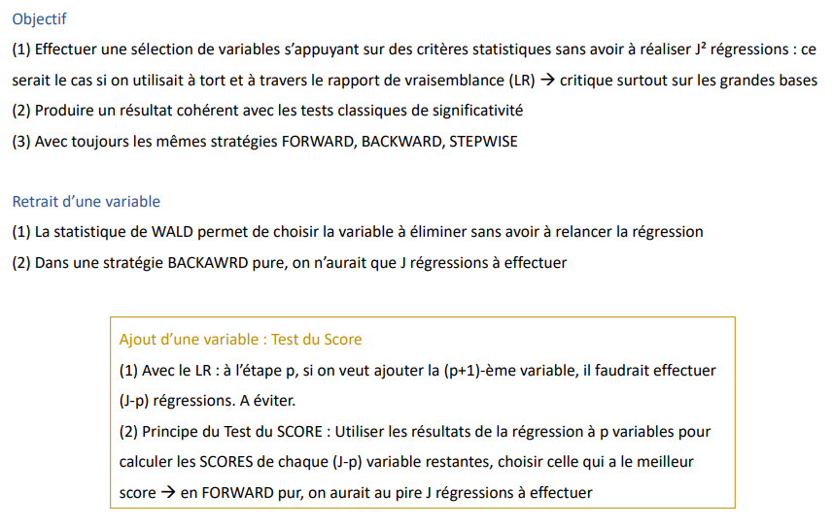
Selection based on statistical criteria Score test and Wald test
Logistic Regression
Objective
(1) To perform a selection of variables based on statistical criteria without having to perform J² regressions: this would be the case if the likelihood ratio (LR) was used incorrectly -- critical especially on large bases
(2) To produce a result consistent with the classical tests of significance
(3) With always the same strategies FORWARD, BACKWARD, STEPWISE
Removing a variable
(1) The WALD statistic makes it possible to choose the variable to be eliminated without having to restart the regression
(2) In a pure BACKAWRD strategy, we would only have to run J regressions
Adding a variable: Score test
(1) With LR: at step p, if we want to add the (p+1)th variable, we would have to run (J-p) regressions. To be avoided.
(2) Principle of the SCORE Test: Use the results of the p-variable regression to calculate the SCORES of each (J-p) remaining variable, choose the one with the best score → in pure FORWARD, one would have at worst J regressions to perform

Slide 52
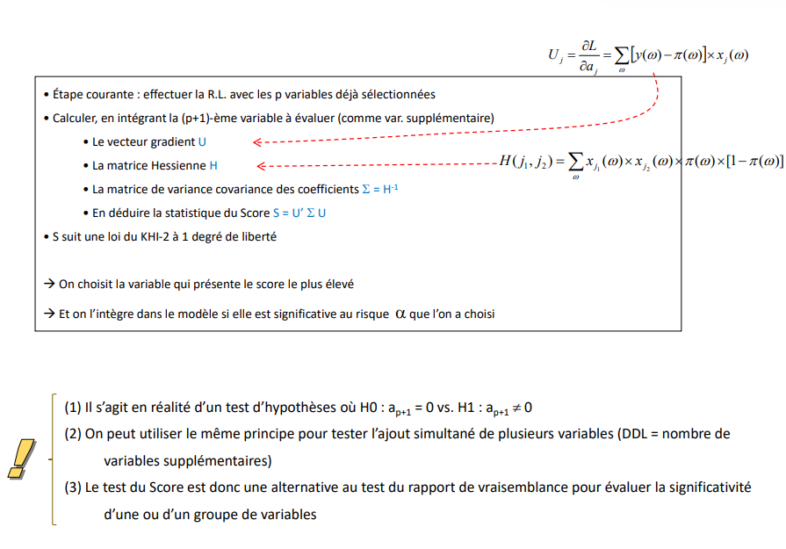
Principle of the Score Test The idea of the additional variable(s)
Logistic Regression
- Current step: perform the L.R. with the p variables already = selected
- Compute, by integrating the (p+1)-th variable to be evaluated (as additional var.)
- The gradient vector U
- The Hessian matrix H
- The variance covariance matrix of the coefficients Σ = H-1
- Deduce the Score S = U' Σ U
- S follows a KHI-2 law with 1 degree of freedom
→ We choose the variable with the highest score
→ And it is included in the model if it is significant at the chosen risk α
(1) This is actually a hypothesis test where H0: ap+1 = 0 vs. H1: ap+1 ≠ 0
(2) The same principle can be used to test the simultaneous addition of several variables (DDL = number of additional variables)
(3) The Score test is therefore an alternative to the likelihood ratio test for assessing the significance of one or a group of variables

Slide 53
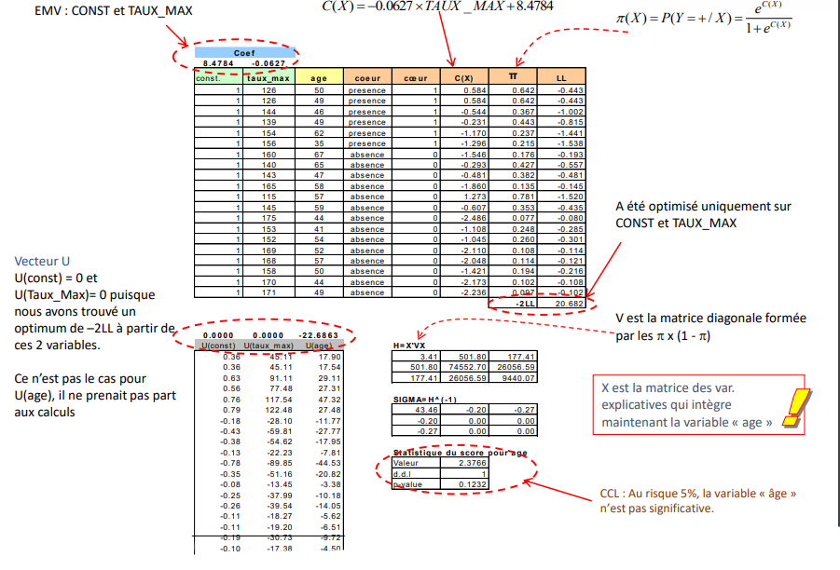
Testing the Score - An example Evaluate the addition of "age" in a model where there is already the constant and max rate
Logistic Regression
Has been optimized only on CONST and RATE_MAX
Vector U
U(const) = 0 and U(Rate_Max)= 0 since we have found an optimum of -2LL from these 2 variables. This is not the case for U(age), it did not take part in the calculations
V is the diagonal matrix formed by the π x (1 - π)
X is the matrix of var. explanatory matrix that now includes the "age" variable
CCL: At the 5% risk, the "age" variable is not significant.

Slide 54

Regression Diagnostics
Logistic Regression
Residual analysis
Determine if there are observations that are very poorly explained
Determine if some observations deviate significantly from others
Determine if some individuals have an exaggerated weight on the results (influential points)

Slide 55
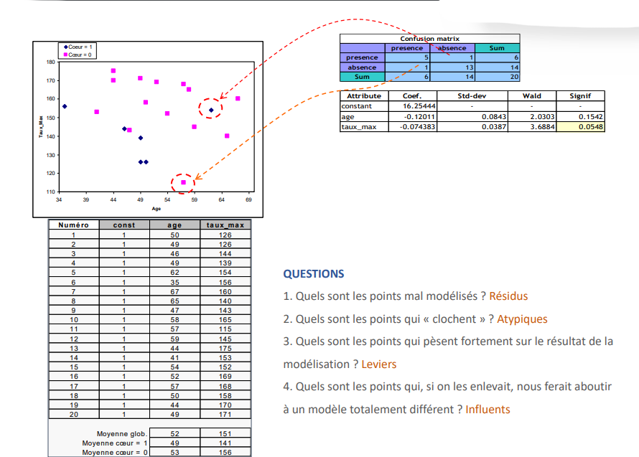
Example of reference Heart = f (age ; rate_max)
Logistic Regression
QUESTIONS
1. What are the poorly modelled points? Residuals
2. What are the points that are "wrong"? Atypical
3. What are the points that weigh heavily on the result of the result of the modelling? Levers
4. What are the points that, if removed, would lead us to a totally different a totally different model? Influencers

Slide 56
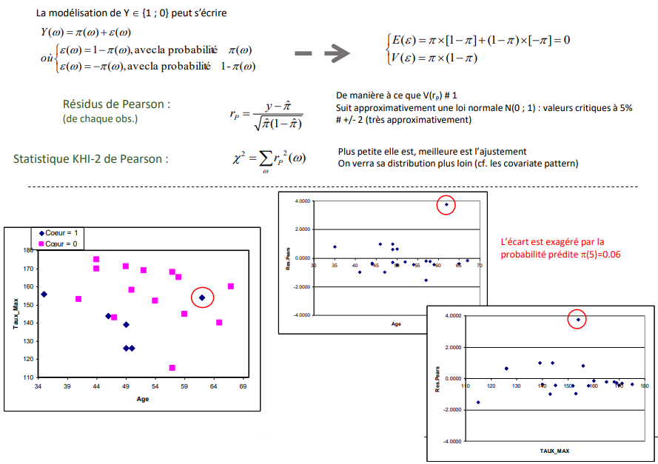
Pearson's Residue
Logistic Regression
The modelling of Y € {1 ; 0} can be written
with the probability
with the probability
Pearson Residuals:
(from each obs.)
So that V(rP ) # 1
Follows approximately a normal distribution N(0; 1): critical values at 5%.
# +/- 2 (very approximately)
Pearson's KHI-2 statistic:
The smaller it is, the better the fit
We will see its distribution later (cf. the covariate pattern)
The gap is exaggerated by the
predicted probability π(5)=0.06

Slide 57
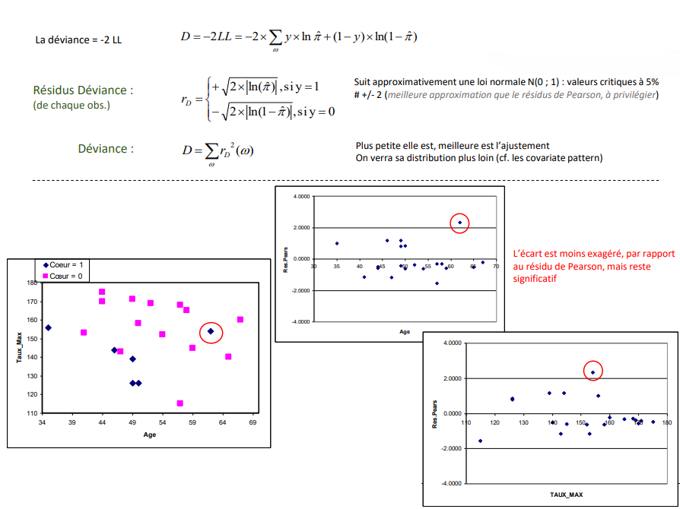
Residue Deviance
Logistic Regression
The modelling of Y € {1 ; 0} can be written
Pearson Residuals:
(from each obs.)
Approximately follows a normal distribution N(0; 1): critical values at 5%.
# +/- 2 (better approximation than Pearson's residual, to be preferred)
Deviance
The smaller it is, the better the fit
We will see its distribution later (cf. the covariate pattern)
The gap is less exaggerated, compared to the Pearson residual, but is still significant

Slide 58

Lever (1) - Distance from other points
Logistic Regression
The HAT-MATRIX is written
(H is symmetric)
V is the diagonal matrix of π(1- π)
X (n,J+1) includes the constant on the 1st column
Read on the main diagonal of H
# The distance of a point from the barycentre
Weighted by the quantity π(1- π)
For an observation
hatvalues() in R
We can verify that
A simple detection rule would be h >= 2xh
Detecting the points that "drop out" is better
The modelling of Y € {1 ; Warning:
→ h is overestimated when π ~ 0.5
→ h is underestimated when π ~ 1 or π ~ 0 (e.g., ω =7)0} can be written

Slide 59

Lever (2) - Measure the overall influence of an observation
Logistic Regression
The prediction of point n°j depends on the values read in its column in the matrix H i.e., hi,j indicates the influence of point i in the prediction of point j
Another reading of the lever (Multiple linear regression)
The value on the diagonal of the matrix H indicates the (global) influence of the point n°i in the prediction of the values of each point n°j
Now, we can show that (applies to the Reg.Log.)
hi=J+1, point n°i totally determines the prediction of all other points
hi=0, point n°i has no influence on the prediction of the other points
The HAT-MATRIX is written
(H is symmetric)
Removal of item #17 affects predictions very little
Removing point #6 significantly affects predictions
how to quantify this ?

Slide 60

Lever (2) - Measure the overall influence of an observation
Logistic Regression
Principle:
For each observation
- Compute the residual, Y deviation and Predicted Probability
- Without the point intervening in the regression, i.e., in additional data
- Without having to perform "n" (size of the database) regressions
- Distributions and thresholds (+/- 2 for a ~5% test) are the same
Standardized Pearson Residual
Standardized Deviance Residue
(preferred)
rstandard() in R
RSTUDENT in SPSS

Slide 61

Cook's distance - Overall effect on all estimated coefficients
Logistic Regression
Principle:
Compare the estimated coefficients, with and without the item to be evaluated
H0 test: all coefficients are identical vs. H1: at least 1 is different
Without having to perform "n" (size of the base) regressions
Cook's distance
Defined on the standardized deviance residue
cooks.distance() in R
The usual detection rule is
Point n°6 is correctly modelled (cf. residual) but has a strong influence on the results (cf. Leverage + D.Cook)
Point n°11 is poorly modelled (standardized "limit" residual) and has a strong influence on the results (cf. Leverage + D.Cook)
Point n°5 is very poorly modelled, but it has less influence on the results than points 6 and 11.
Remarks:
- D can be defined on the Pearson residual (be careful with small/large values of )
- Some do not normalize by the number of parameters (J+1) [e.g., SPSS] the detection rule is then D 1

Slide 62

DFBETAS - Effect on each estimated coefficient
Logistic Regression
Principle: Compare each estimated coefficient, with and without the item to be evaluated H0 test -- The coefficients are identical in both regressions
Objective -- To identify on which variable the influential item weighs the most. This also allows us to understand how the item is atypical
DFBETAS
Formula used in SAS
dfbetas() of R seems to be based on the standardized deviance residue ?
The usual detection rule is
Note: Standard deviation of coefficient
We understand better:
→ #6 weighs mostly on age
→ 11 is mostly about rate
→ 5 is (presumably) a problem

Slide 63
"covariate pattern" and associated statistics
Logistic Regression
Evaluation measures based on residuals

Slide 64

Notion of "covariate pattern"
Logistic Regression
When the data are made up of nominal/ordinal variables Or when the data are from experiments
→ Several observations share the same description
→ Each description is called a "covariate pattern
Ex. hypertension = f (overweight; alcohol)
→ Surpoids = {1 ; 2 ; 3}
→ Alcohol = {1 ; 2 ; 3}
There are M = 9 possible "covariate patterns (9 "distinct" observations)
Number of people in each covariate : nm
Proportion of positives in each covariate
Number of positives in each covariate
What's the point?
- Develop new evaluation statistics based on residuals
- Detect groups (covariates) with particular characteristics (influences)

Slide 65

Estimation and calculation table For the "Hypertension" example
Logistic Regression
The elements of diagnosis which will come will be the expression of the confrontation of these two quantities
Proportion of positives observed for each covariate pattern
Proportion of positives predicted (by the model) for each covariate pattern
Both factors lead to an increased risk of hypertension. risk of hypertension.
Calculation table: comparison of "observation" and "prediction

Slide 66

Lever of each covariate pattern
Logistic Regression
“Lever" reminder
- Indicates the distance of a covariate from the others
- Indicates the influence of a covariate in the prediction of the probabilities of the other covariates
(Lever = J+1, it determines all predictions; lever = 0, no influence)
For the covariate " m "
(we have M distinct covariates)
Warning: (X'VX)-1 is always the matrix of variance covariance of the coefficients calculated on the n observations.
Covariate #7 is a major determinant of the results. To a lesser extent covariates #3 and #1.
→ This does not mean that these covariates are problematic, the residual analysis should tell us. problematic, the analysis of the residuals should tell us so

Slide 67

Pearson's residuals And covariates pattern
Logistic Regression
The greater the chance that:
(1) The prediction is poor
(2) The number of people is low
(3) The probability is close to 0 or 1
Pearson's residual
(for covariates)
Pearson's residual
(for covariates)
If nm is large enough, whatever m is, then the statistic follows a KHI-2 law with (M-J-1) degrees of freedom.
Warning: if continuous predictive (M#n) the approximation by the KHI-2 law is not valid!!!
Contribution to the Pearson Pearson's statistic (standardised residual squared)
Shows the change in Pearson's KHI-2 if we remove the covariate "m" from the regression
Poorly modelled, although |r.pears| clearly less than 2, if we removed them removed, the fit would be even better (decrease of KHI-2 by 3.716)
A possible comparison value possible comparison value would be ²(1) at 5% # 3.84
The KHI-2 (7.0711) is not significant (p-value = 0.3143) i.e., the predicted probabilities are not significantly different from the observed probabilities → the model predicts well overall

Slide 68

Residual deviance And covariate pattern
Logistic Regression
Residual Deviance
(for covariates)
Deviance
Indicates the difference between the observed and predicted probabilities If nm is large enough, whatever m, then the statistic follows a KHI-2 law with (M-J-1) degrees of freedom.
Danger: if continuous predictive (M#n) the approximation by the KHI-2 law is illicit!!!
Contribution to the
Deviance
Indicates the change in Deviance (D) if we remove the
covariate "m" from the regression
Residual deviance
Deviance calculation
Delta deviance if withdrawal
of the covariate
We really need to look at this covariate on this covariate: if you remove it removed, the fit would be much better (decrease of the deviance of 5.587)
A possible comparison value would be X²(1) at 5% # 3.84
The KHI-2 (7.0690) is not significant (p-value = 0.3145) i.e., the predicted probabilities are not significantly different from the observed probabilities → the model predicts well overall.

Slide 69

C and CBAR Indicate the effect of deleting a variable on the coefficients
Logistic Regression
Principle: To indicate the effect of removing a covariate on the coefficients (difference between the coefficients vectors)
- Carries the same idea as the Cook distance (it is a possible alternative)
- Available in SAS (Cook's distance is available in R)
CBAR statistics
The C statistic
hm < 1 → The C indicator makes the effect of high leverage (hm) even stronger leverage (hm) compared to CBAR
Calculation table: C and CBAR
The covariates n°3 and n°7 have a significant influence on the calculated coefficients. Already identified with the lever. Covariate n°3 stands out all the more because it is (relatively) poorly modelled (see residuals).
→ We can refine the analysis with the DFBETAS: effect of the covariate on this or that coefficient...

Slide 70

DFBETAS and DFBETA And covariate pattern
Logistic Regression
DFBETA
(for covariates)
Absolute deviation of the estimated coefficient with or without the covariate
DFBETAS
(for covariates)
Standard deviation of the estimated coefficient
Remark : When the data are (1) on the same scale (ex. same units) or (2) directly scales of values (cf. our example) or (3) indicators, it is better to use directly the DFBETA, as the covariates pattern is often manipulated in the last two configurations
Calculation table: C and CBAR
Deletion of covariates #3 and n°7 leads to a strong modification of the coefficients with, moreover, reversed effects on the two variables. variables.
How to read these values ? If we remove the covariate n°7, the coefficient of "overweight" will be increased by 0.106, and that of "alcohol" decreased by 0.156 i.e.
Estimation of aj without the covariate "m"

Slide 71

DFBETA The example of covariate n°7
Logistic Regression
Regression on all covariates
DFBETA for covariate #7
Coefficients without covariate n°7
The difference is attributable to truncation errors in the manual recovery of coefficients.
Without covariate #7 (the skinny alcoholic), the effect of alcohol on hypertension would no longer be significant (at 5%). We can see the very important role that this covariate plays!!!

Slide 72


some additional elements
Logistic Regression
Better understand, anticipate and improve the performance of Logistic Regression

Slide 73

Logistic Regression
non-linearity on the LOGIT
Linearity on LOGIT → a one unit increase in X1 results in an increase in "a1" of the LOGIT, regardless of the value of X1.
Non-linearity on the LOGIT → the variation of the LOGIT following a variation of X1 depends on the level (or value) of X1.

Slide 74

Univariate graphical identification The LOGIT vs. independent variable (continuous) graph
Logistic Regression
LOGIT graph
- Divide X into deciles (or others)
- In each interval, calculate the proportion of positives π
- Build the graph :
→ on the x-axis, centre of the intervals
→ on the ordinate, observed LOGIT i.e., LN [π/(1- π)]
We note an evolution by stages, absolutely not linear.
It is nevertheless monotonous.
Solution: Variable transformation.
The simplest : discretization of the continuous variable (grouping into classes)
Constrained "cumulative" coding (for ordinal var.) To take into account the information on monotony
Reg.Log. Initial variable
else
else
Reg.Log. Discretized variables
else
Switching to discretized variables decreases the bias (good) but increases the variance (not good) If non-linear + non-monotonic evolution, adopt an unconstrained disjunctive coding (0/1)
→ The best is still not to discretize but to use a transformation function

Slide 75

Box-Tidwell test - Multivariate numerical identification
Logistic Regression
High number of variables → Graphical (individual) detection not possible
Rely on a statistical procedure to identify, and then study in detail, the variables that may be involved in a non-linear way.
Principle: For a variable X to be tested, add in the regression, in addition to the other variables, and in addition to X, the interaction term Z = X * LN(X). If the coefficient of Z is significant, the variable X intervenes in a non-linear form (which remains to be identified).
Note: This test detects poorly small deviations from linearity.
Significant additional variable: BMI intervenes in a non-linear way in the relationship (This is consistent with the previous analysis).
BMI regression alone
Regression BMI AND Z = BMI x LN(BMI)

Slide 76

Multivariate Identification - Partial Residuals (1) Identify the appropriate form of a variable in the regression
Logistic Regression
In simple linear regression: "Scatter plot" to identify the shape of the identify the shape of the relationship between X and Y
Here the relationship seems polynomial Add the variable Z=X² (or substitute for X) in the regression
In multiple linear regression: the individual graph (Xj, Y) is no longer valid because it does not take into account the other variables -- We
then uses the "Partial Residuals".
The cloud must form a line (if linear relationship)
If the cloud does not form a line :
Add (or substitute for) the desired transformation in the regression (inspired by the shape of the scatterplot, e.g., X²), recalculate the regression equation regression equation and construct the graph of the partial (augmented) residuals
If the right transformations have been introduced, the introduced, the cloud should form a line.
All coefficients and forms of the variable

Slide 77

Multivariate identification - Partial residuals (2) The case of logistic regression
Logistic Regression
Elaborate the point cloud (xj, rxj): if OK, it forms a line if not, introduce the transformed variable in the transformed variable in the regression and compute the partial residuals
Partial residuals for logistic regression
Heart = f( age, rate_max)
OK for "age", except for the atypical point
OK for "max rate", except for the atypical point

Slide 78

using weighted MCO's
Logistic Regression
To estimate the parameters of the logistic regression

Slide 79

Weighted regression (1) The generalized least squares method
Logistic Regression
Mean of Y ←→ Probability of Y
By hypothesis
X is non random (independent of ε)
Y² = Y since {0;1}
Heteroskedasticity
Let us take Y {0;1} and define the regression equation with the OLS assumptions
Using the generalized least squares estimator
Z is the predicted LOGIT, corrected for prediction errors for each observation (MMV)
Weight each individual by η (different for each individual)
In other words
V (VCV of the residues) is a matrix of size (n x n) whose diagonal is formed by the π (1 - π)
Conclusion : We know then that
What is the interest (since we need the results of the MMV)
→ Faster/stable iterative methods are based on this result (IRLS: iteratively re-weighted least square)
→ Use regression programs (less resource intensive) for variable selection

Slide 80

Weighted regression (2) Calculations
Logistic Regression
Let us take Y {0;1} and define the regression equation with the OLS assumptions
Reminder Results Logistic regression
Obtained by logistics regression
DROITEREG Function (EXCEL)
We define s² the estimated variance of the residuals
Cf. analogy with OLS SCR/ddl, but weighted here
Standard deviations of poorly estimated coefficients. How to correct ?
Correction of the standard deviations of the regression by the dispersion of errors

Slide 81

Geometric interpretation
Logistic Regression
Link with partitioning learning
Logistic regression = linear classifier

Slide 82

Non-linear regression... But linear separator
Logistic Regression
Let us take Y {0;1} and define the regression equation with the OLS assumptions
Non-linear regression: Transform the linear combination [C(X) = a0 + a1.X1 + ...] using a non-linear transfer function (Fonc. Logistic distribution LOGIT, Fonc. Distribution. Normal function PROBIT, etc.)
BUT…
From the partitioning point of view, the classifier induces a linear separation linear separation in the representation space
Let's take the "Heart Disease" file
Y = f (age, rate_max)
Decision: If c(X)>0 Then Y = +
i.e.
C(X)=0 defines a "border" between
the Y=+ and Y= -
Explicit eq. →

